Slide 1



Lesson 6:
Turtle Crossing

Slide 2
Slide

Slide 3
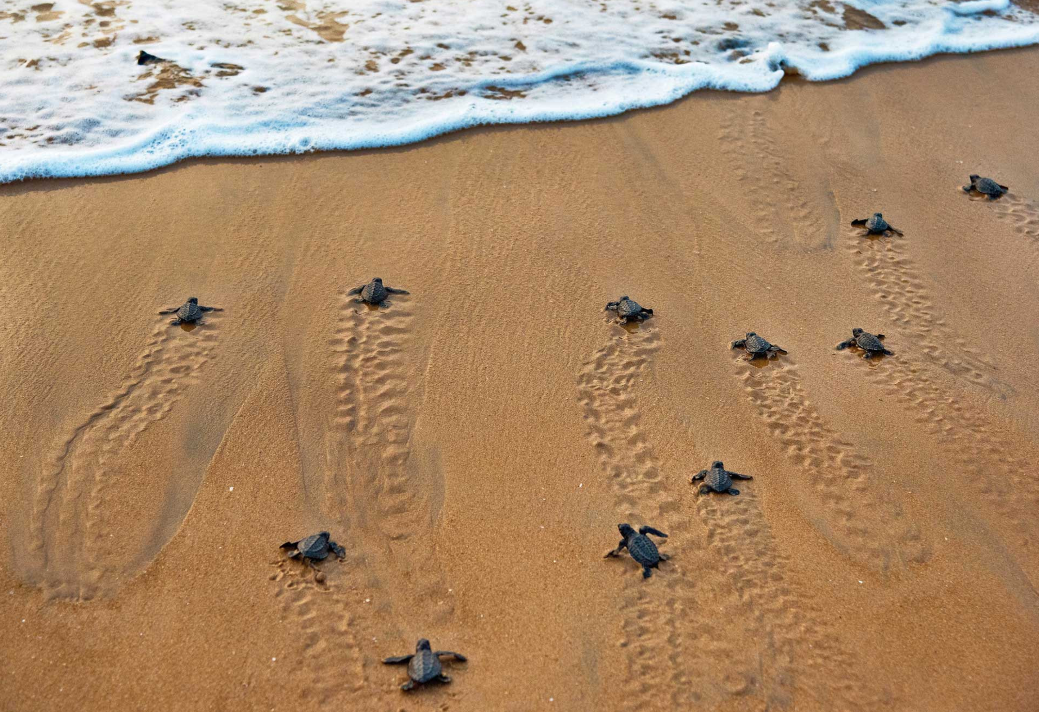
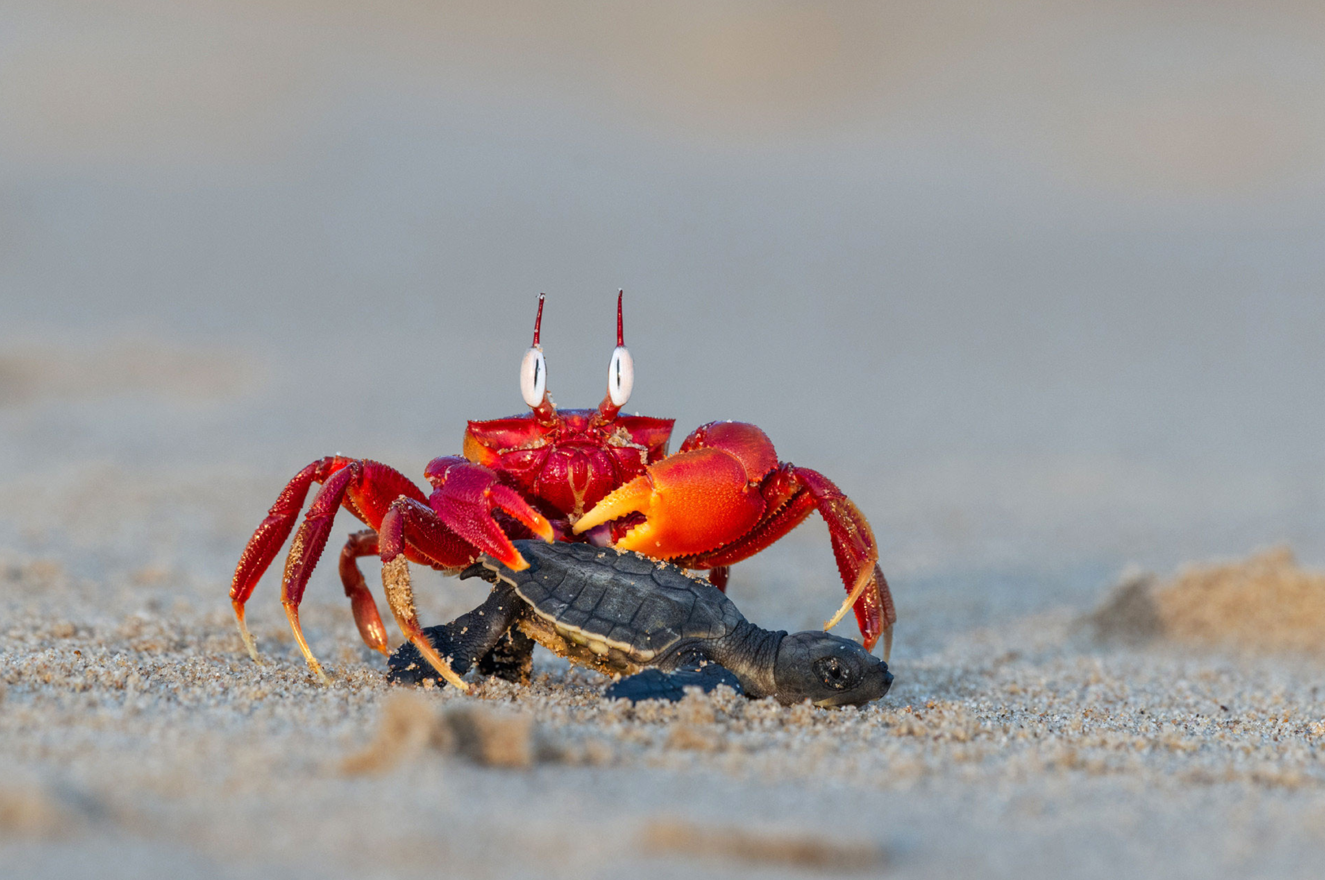
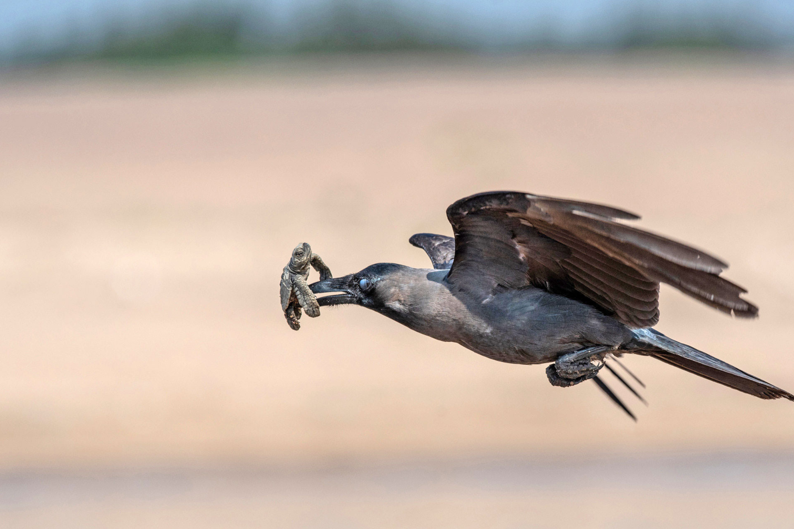
Dangerous Journey…

Slide 4

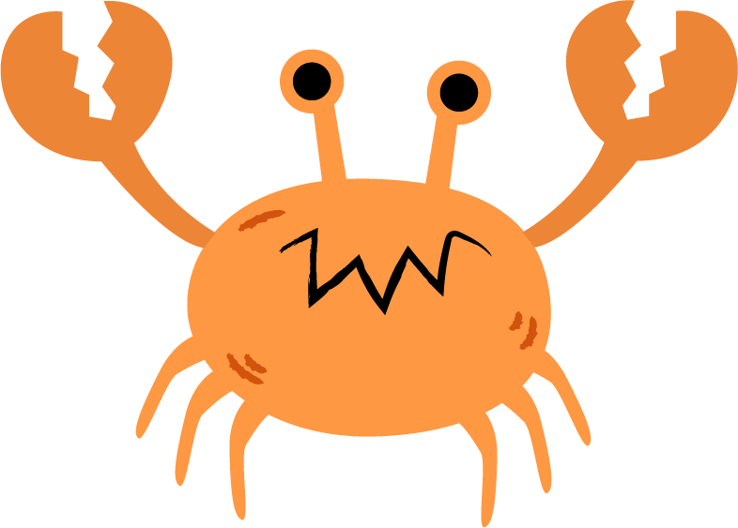

Turtle Crossing

Slide 5
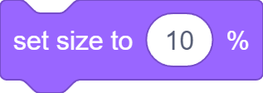


Set Turtle Up

Slide 6
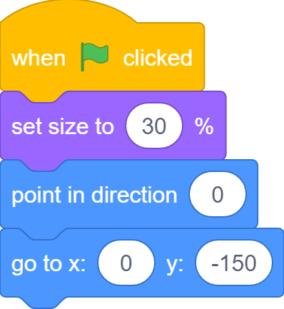
Set Turtle Up

Slide 7
Slide

Slide 8
Slide

Slide 9
Slide

Slide 10
Slide

Slide 11
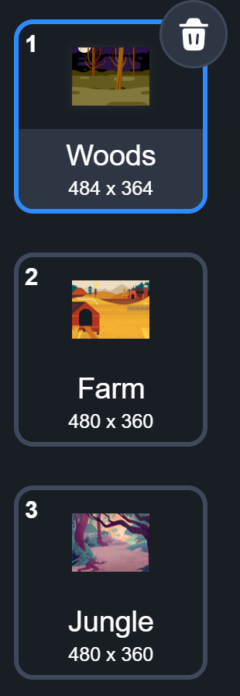
What we learnt…
How to create levels for games using backdrops

Slide 12
Exercises
Can you add even more distractions to the game?
Can you increase the amount of distraction as the players progress from level to level?
What else can you do to make it even harder to find the bug? (think about different effects you can apply to sprites)
Play the game with friends and families to see who is the best bug finder!

Slide 13
Thank you and see you in the next lesson!

